Slide 1
5
APPLICATIONS OF INTEGRATION
Copyright © Cengage Learning. All rights reserved.

Slide 2
5.2
Volumes
Copyright © Cengage Learning. All rights reserved.

Slide 3
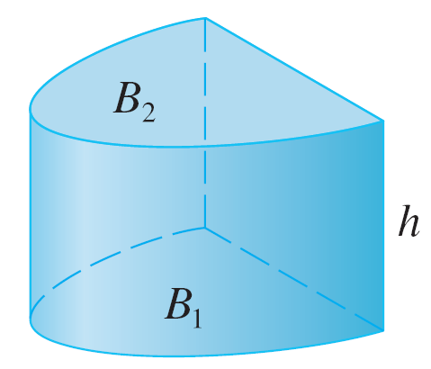
Volumes
We start with a simple type of solid called a cylinder (or, more precisely, a right cylinder). As illustrated in Figure 1(a), a cylinder is bounded by a plane region B₁, called the base, and a congruent region B₂ in a parallel plane.
(a) Cylinder V = Ah
Figure 1

Slide 4

Volumes
The cylinder consists of all points on line segments that are perpendicular to the base and join B₁ to B₂.
If the area of the base is A and the height of the cylinder (the distance from B₁ to B₂) is h, then the volume V of the cylinder is defined as

Slide 5
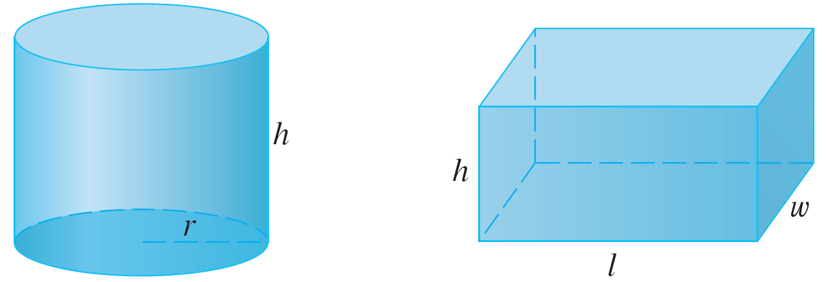
Volumes
In particular, if the base is a circle with radius r, then the cylinder is a circular cylinder with volume V = π r²h [see Figure 1(b)], and if the base is a rectangle with length l and width w, then the cylinder is a rectangular box (also called a rectangular parallelepiped) with volume V = lwh [see Figure 1(c)].
(b) Circular cylinder V = π r²h
(c) Rectangular box V = lwh
Figure 1

Slide 6
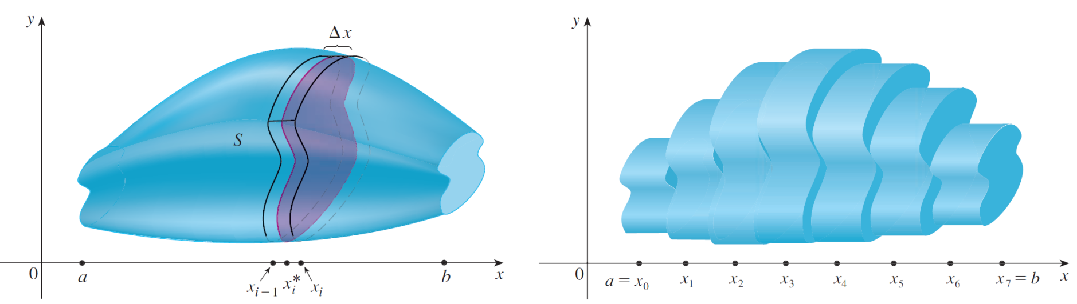
Volumes
For a solid S that isn’t a cylinder we first “cut” S into pieces and approximate each piece by a cylinder.
We estimate the volume of S by adding the volumes of the cylinders. We arrive at the exact volume of S through a limiting process in which the number of pieces becomes large.

Slide 7
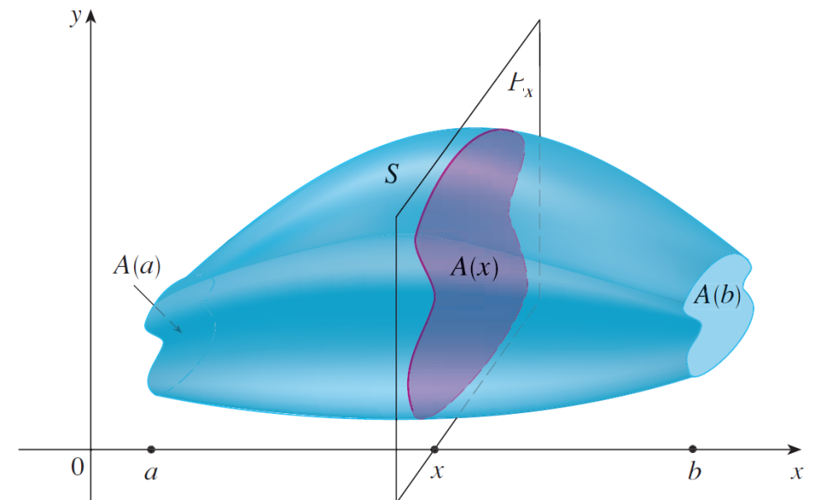
Volumes
We start by intersecting S with a plane and obtaining a plane region that is called a cross-section of S.
The intersecting plane Px is perpendicular to the x-axis and passing through the point x.
A(x) is the area of the cross section.

Slide 8

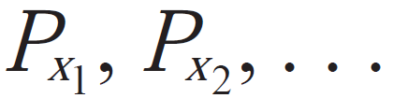
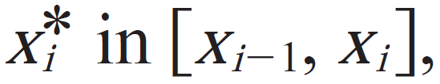


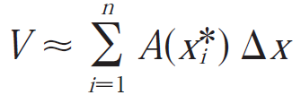
Volumes
Let’s divide S into n “slabs” of equal width by using the planes to slice the solid.
If we choose sample points we can approximate the ith slab Si by a cylinder with base area and height .

Slide 9
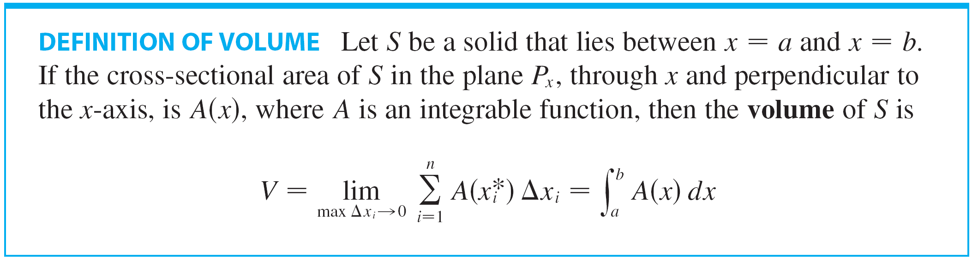

Volumes
The following is the definition of volume:
When we use the volume formula it is important to remember that A(x) is the area of a moving cross-section obtained by slicing through x perpendicular to the x-axis.

Slide 10

Volumes
Notice that, for a cylinder, the cross-sectional area is constant: A(x) = A for all x.
So our definition of volume gives ; this agrees with the formula V = Ah.

Slide 11

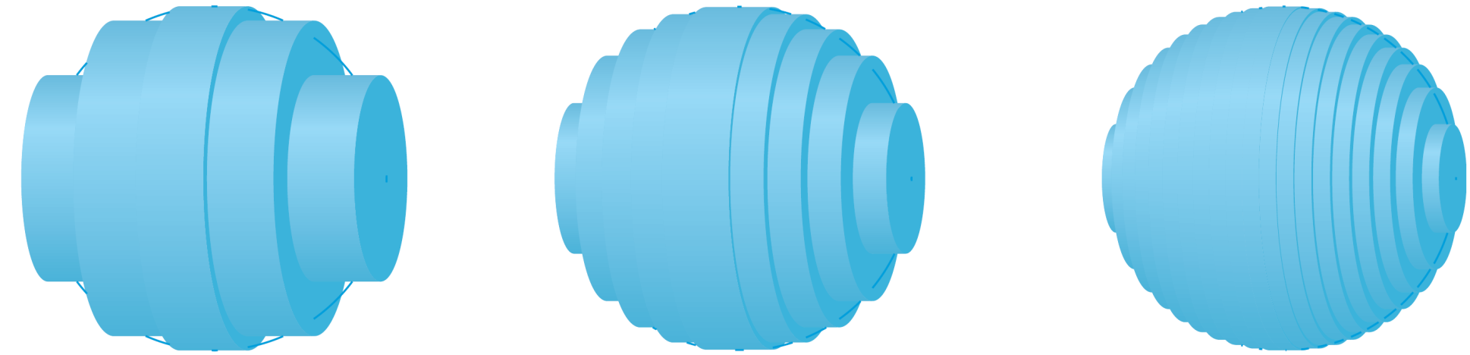
Volumes
Figure 5 illustrates the definition of volume when the solid is a sphere with radius r = 1.
We know that the volume of the sphere is .
(a) Using 5 disks, V ≈ 4.2726
(b) Using 10 disks, V ≈ 4.2097
(c) Using 20 disks, V ≈ 4.1940
Approximating the volume of a sphere with radius 1
Figure 5

Slide 12
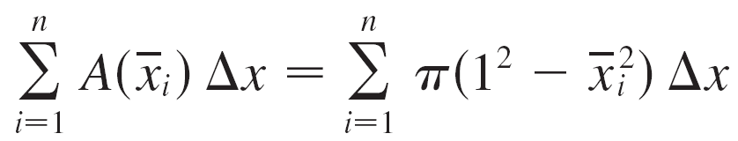
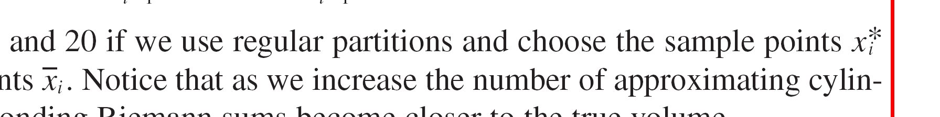
Volumes
Here the slabs are circular cylinders, or disks, and the three parts of Figure 5 show the geometric interpretations of the Riemann sums
when n = 5, 10, and 20 if we use regular partitions and choose the sample points to be the midpoints .
Notice that as we increase the number of approximating cylinders, the corresponding Riemann sums become closer to the true volume.

Slide 13


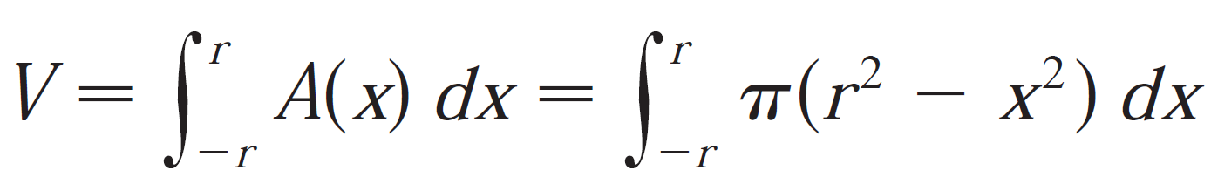
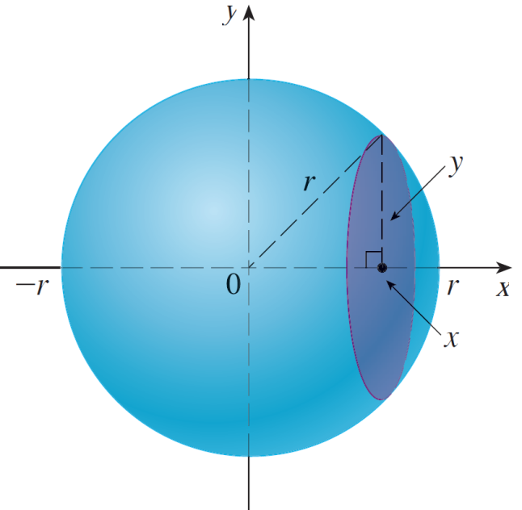
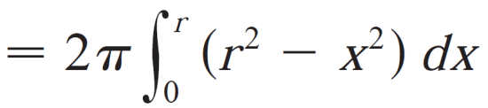
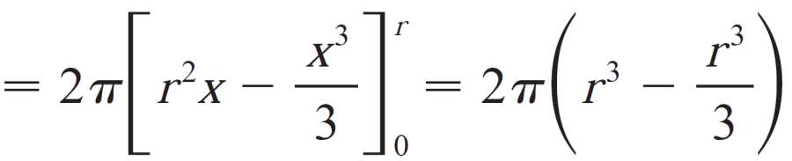
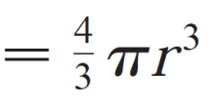
Example 1 Volume of a sphere
In general, a sphere of radius r satisfy
The cross-section area is
Using the definition of volume with a=-r, b=r, we have

Slide 14
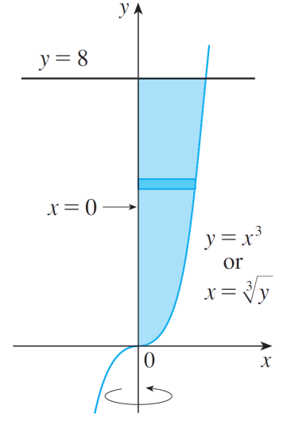
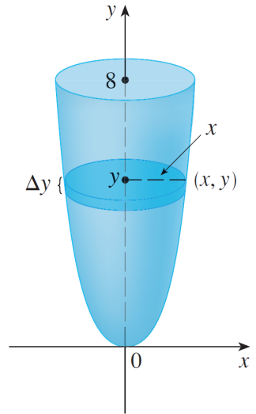
Example 3
Find the volume of the solid obtained by rotating the region bounded by y = x³, y = 8, and x = 0 about the y-axis.
Solution:
The region is shown in Figure 7(a) and the resulting solid is shown in Figure 7(b).
(a)
(b)
Figure 7

Slide 15
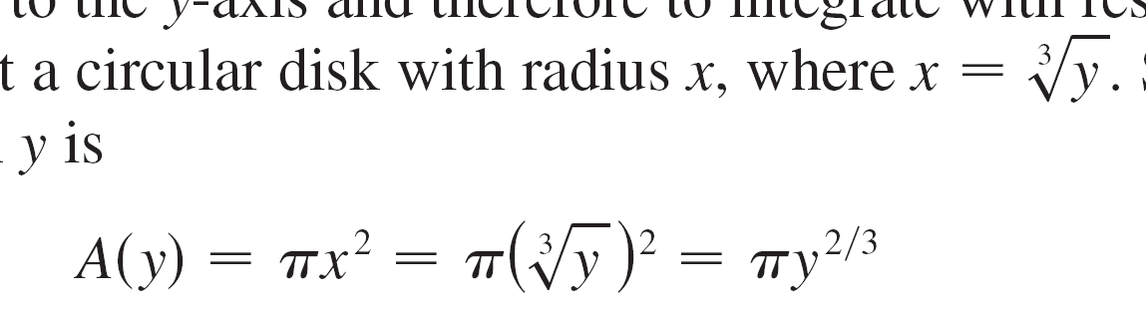

Example 3 – Solution
cont’d
Because the region is rotated about the y-axis, it makes sense to slice the solid perpendicular to the y-axis and therefore to integrate with respect to y.
If we slice at height y, we get a circular disk with radius x, where
So the area of a cross-section through y is
And the volume of the approximating cylinder pictured in Figure 7(b) is

Slide 16
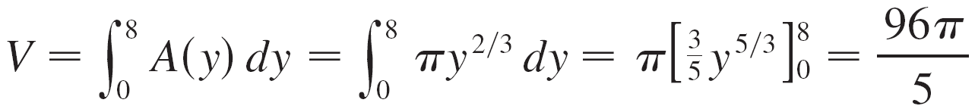
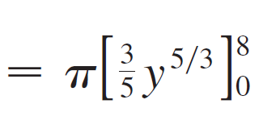
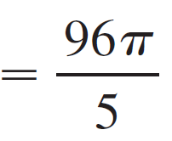
Example 3 – Solution
cont’d
Since the solid lies between y = 0 and y = 8, its volume is

Slide 17

Example 4
The region enclosed by the curves y = x and y = x² is rotated about the x-axis. Find the volume of the resulting solid.
Solution:
The curves y = x and y = x² intersect at the points (0, 0) and (1, 1).

Slide 18
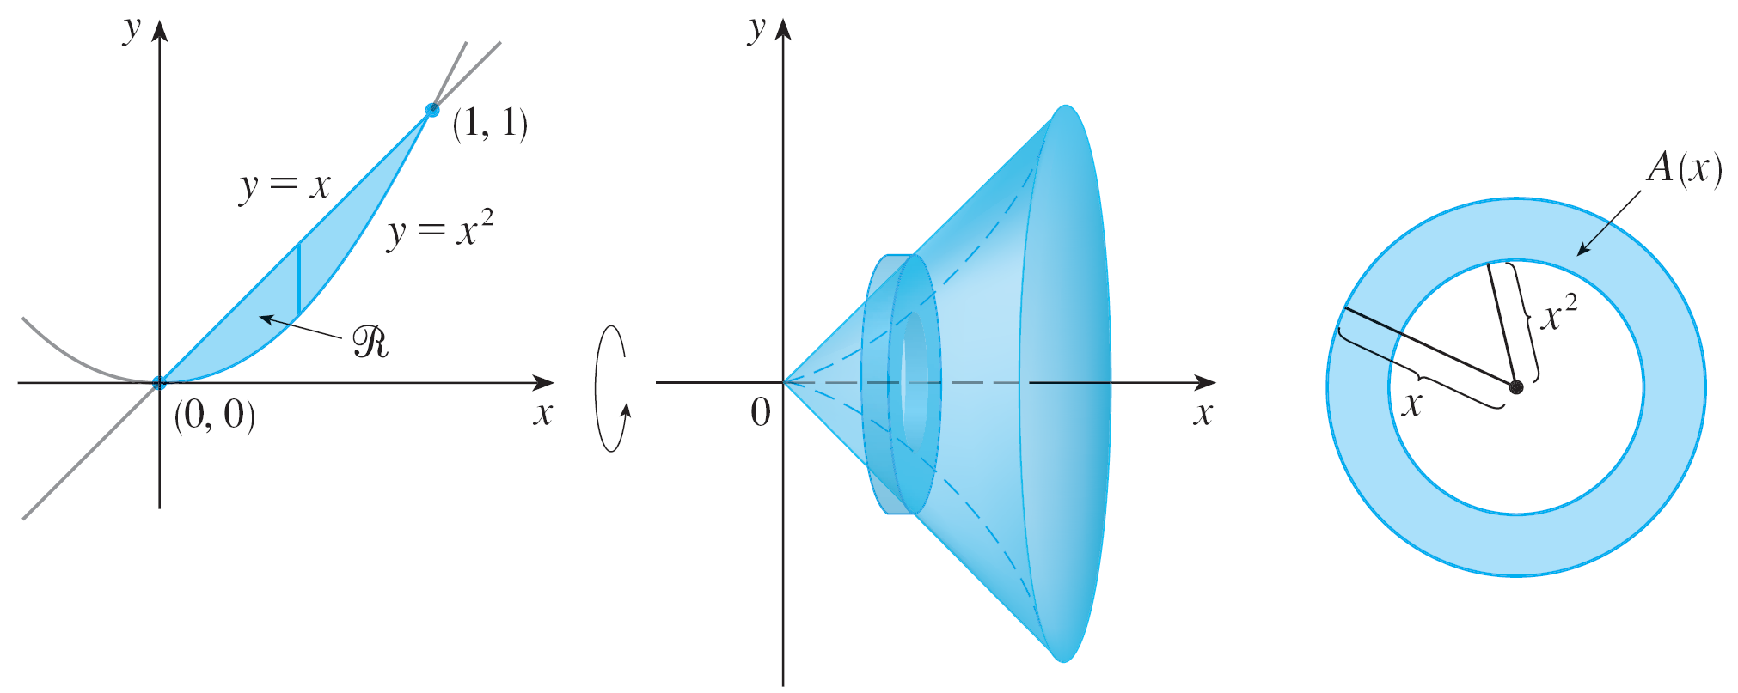
Example 4 – Solution
cont’d
The region between them, the solid of rotation, and a cross-section perpendicular to the x-axis are shown in Figure 8.
(a)
(b)
(c)
Figure 8

Slide 19

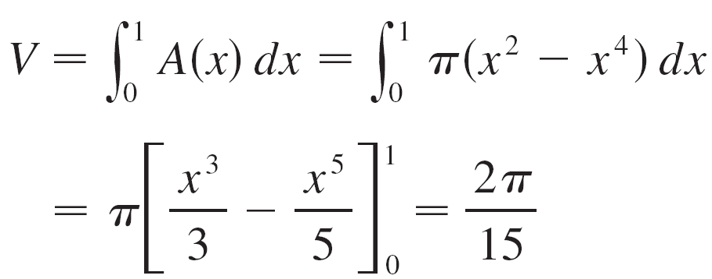
Example 4 – Solution
cont’d
A cross-section in the plane P_{x} has the shape of a washer (an annular ring) with inner radius x² and outer radius x, so we find the cross-sectional area by subtracting the area of the inner circle from the area of the outer circle:
Therefore we have

Slide 20
Volumes
The solids in Examples 3 and 4 are called solids of revolution because they are obtained by revolving a region about a line.

Slide 21
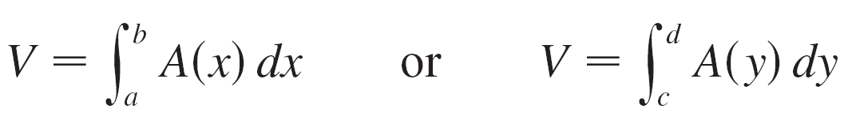

Volumes
In general, we calculate the volume of a solid of revolution by using the basic defining formula
and we find the cross-sectional area or in one of the following ways:
If the cross-section is a disk (as in Example 3), we find the
radius of the disk (in terms of x or y) and use

Slide 22
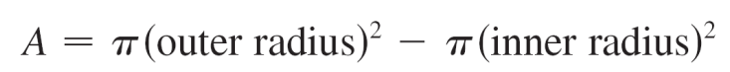
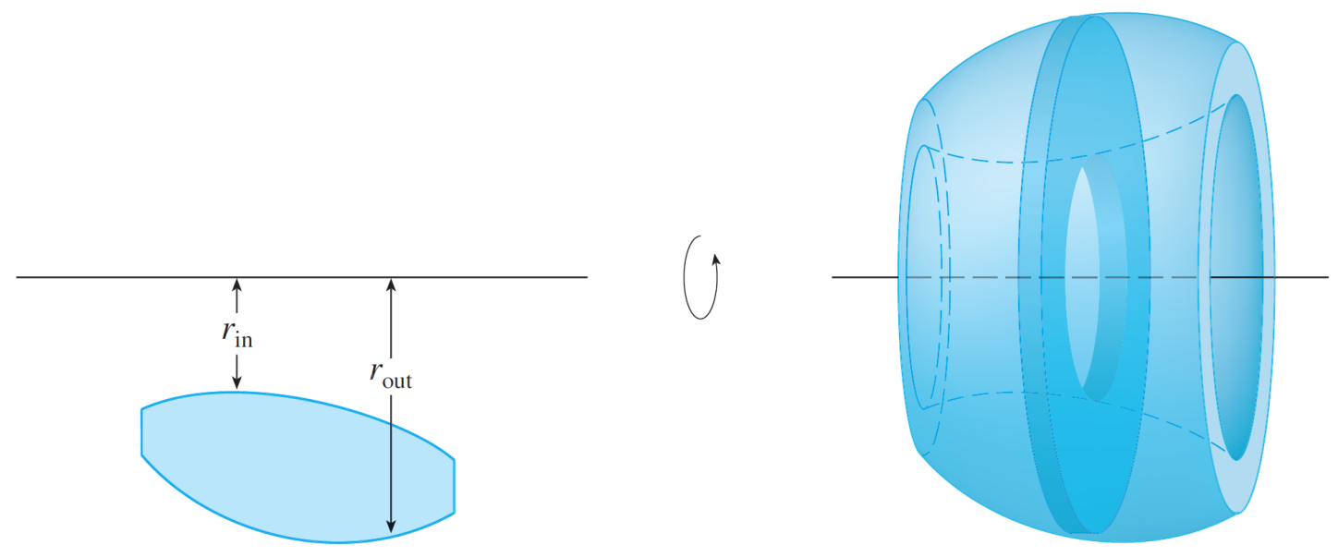
Volumes
If the cross-section is a washer (as in Example 4),
we find the inner radius r_{in} and outer radius r_{out} from a
sketch (as in Figure 10) and compute the area of
the washer by subtracting the area of the inner disk from
the area of the outer disk:
Figure 10

Slide 23
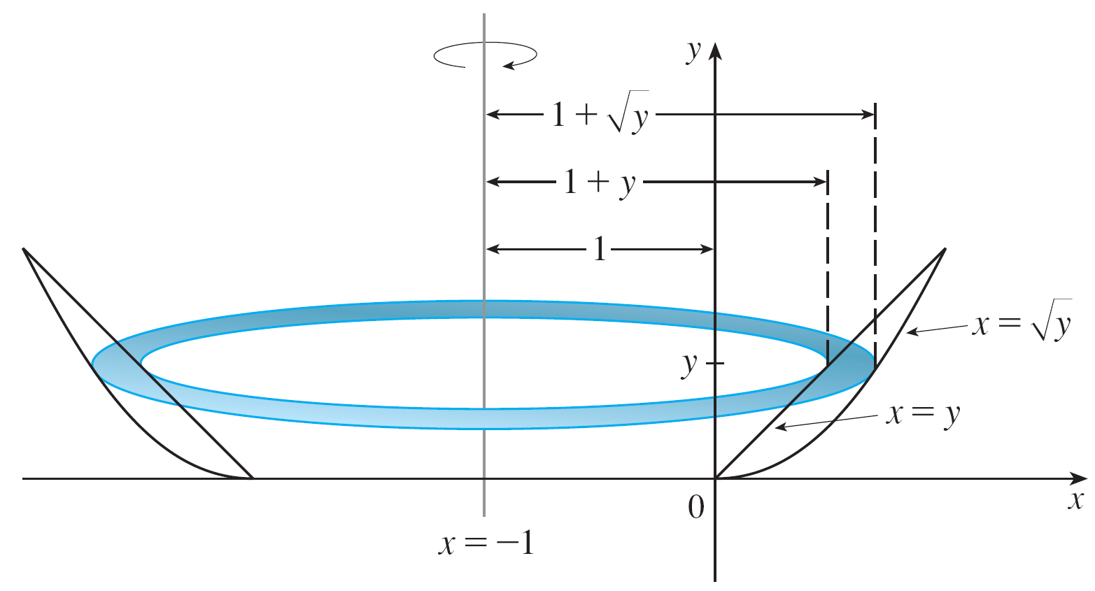
Example 6
Find the volume of the solid obtained by rotating the region in Example 4 about the line x = –1.
Solution:
Figure 11 shows a horizontal cross-section.
Figure 11

Slide 24

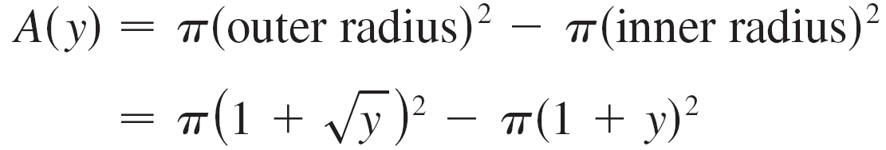
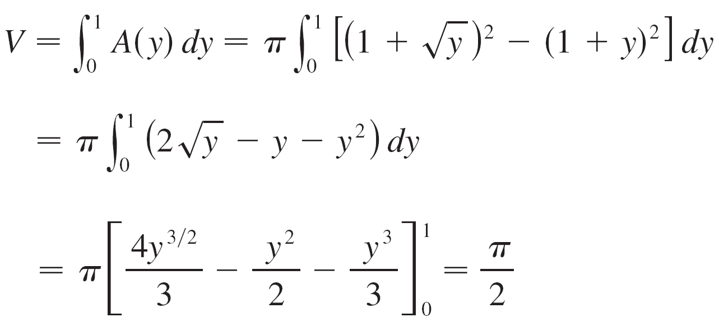
Example 6 – Solution
cont’d
It is a washer with inner radius 1 + y and outer radius
1 + so the cross-sectional area is
The volume is

Slide 25
Example 6 – Solution
cont’d

Slide 26
Volumes
We now find the volumes of two solids that are not solids of revolution.

Slide 27
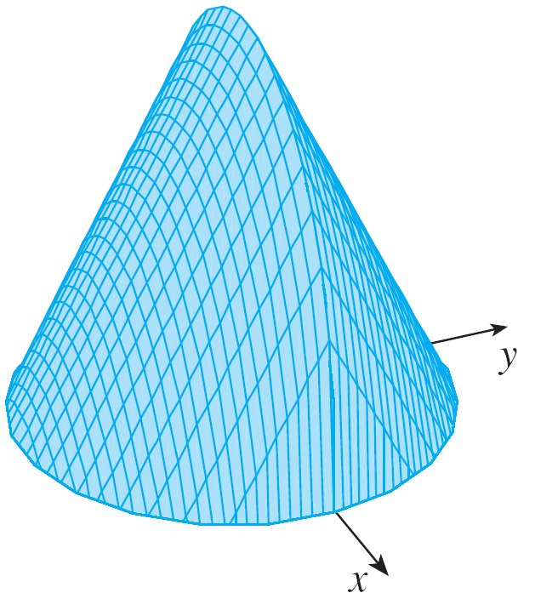
Example 7
Figure 12 shows a solid with a circular base of radius 1. Parallel crosssections perpendicular to the base are equilateral triangles. Find the volume of the solid.
Computer-generated picture of the solid in Example 7
Figure 12

Slide 28
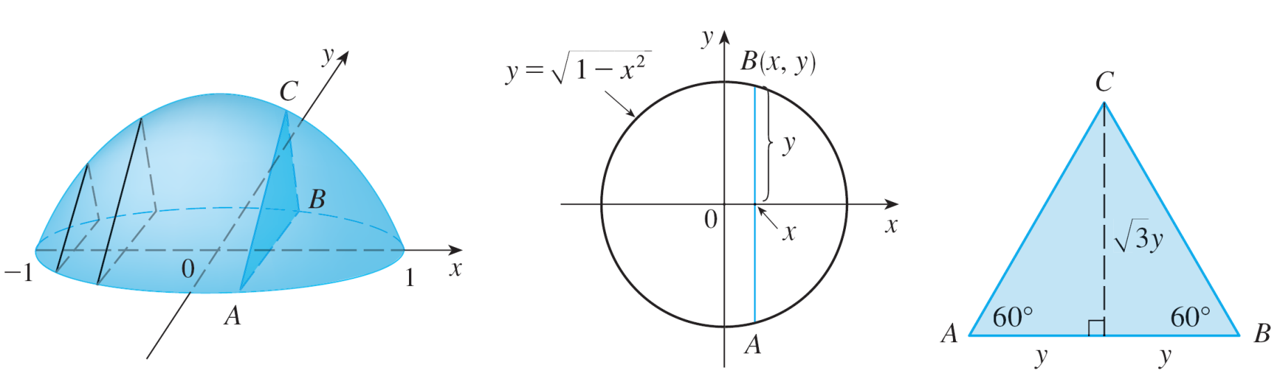
Example 7 – Solution
Let’s take the circle to be x² + y² = 1. The solid, its base, and a typical cross-section at a distance x from the origin are shown in Figure 13.
(a) The solid
(b) Its base
(c) A cross-section
Figure 13

Slide 29
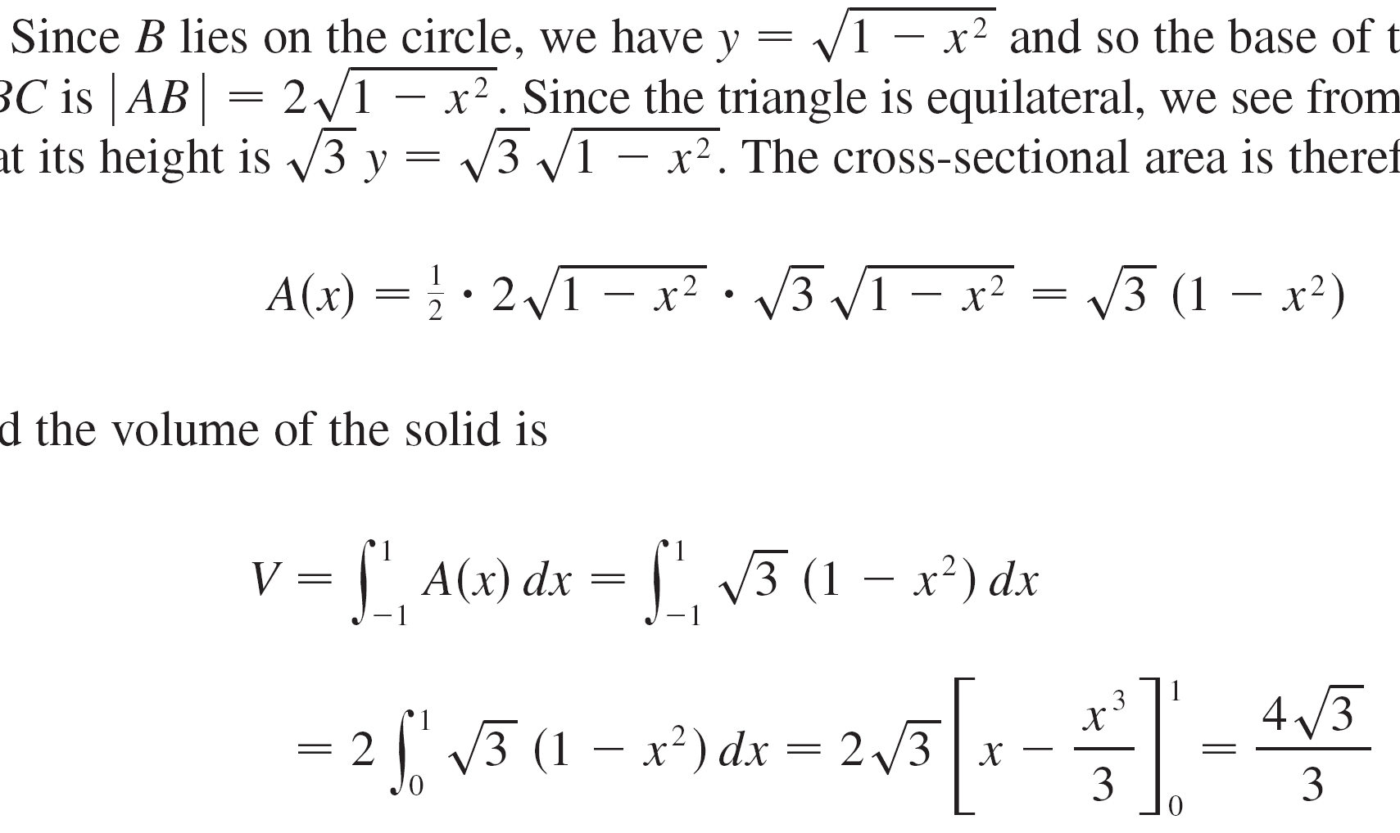
Example 7 – Solution
cont’d
Since B lies on the circle, we have and so the base of the triangle ABC is .
Since the triangle is equilateral, we see from Figure 13(c) that its height is
The cross-sectional area is therefore
And the volume of the solid is

Slide 30
Example 7 – Solution
cont’d

